Slide 1
The knapsack problem (3D)
Group 8
Adam Eljasiak
Daniel Kaestner
Simon Wengeler
Raffaele Piccini
Nicola Gheza
Henri Viigimäe

Slide 2
Contents
1. Greedy algorithm
1.1 Implementation
1.2 The placement method
1.3 Experiments and results
2. Hill climbing algorithm
2.1 Implementation
2.2 Experiments and results
3. Genetic algorithm
3.1 Implementation
3.2 Experiments and results
4. Comparison between algorithms
5. Assignment results
5.1 Using rectangular packages
5.2 Using pentomino-shaped packages

Slide 3
GREEDY ALGORITHM

Slide 4
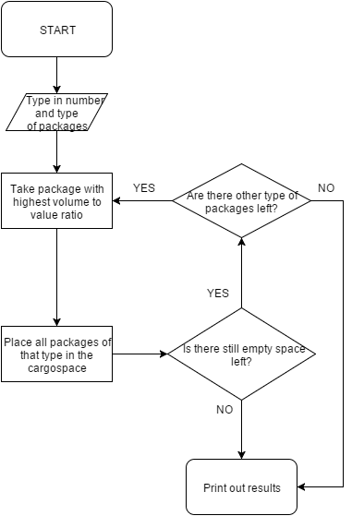
Implementation

Slide 5
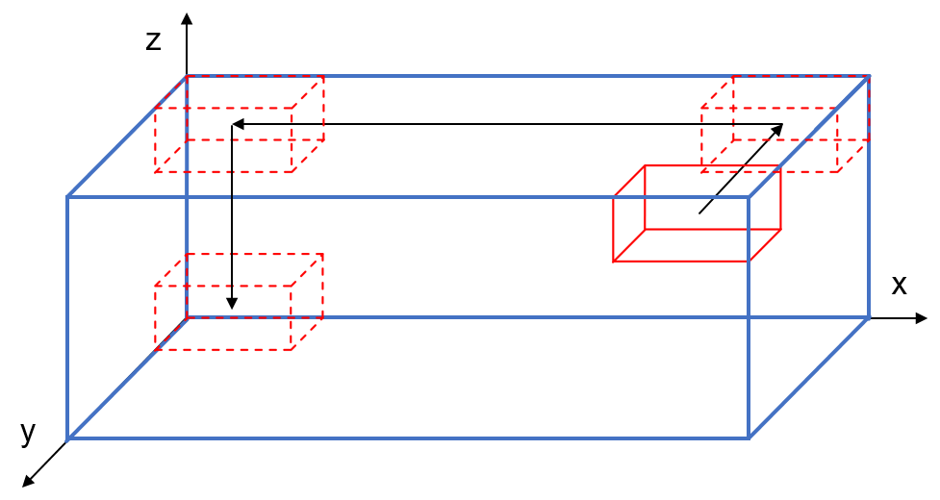
The placement method
Initial position
Is there an overlap at the initial position?
Move package as far to the back (y-axis), then as far to left (x-axis) and as far down (z-axis) as possible

Slide 6
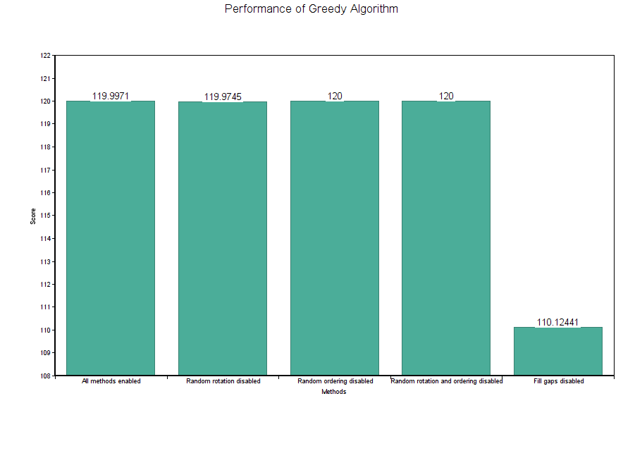
Experiments and results
Finding the best total value
10 packages
100000 runs

Slide 7
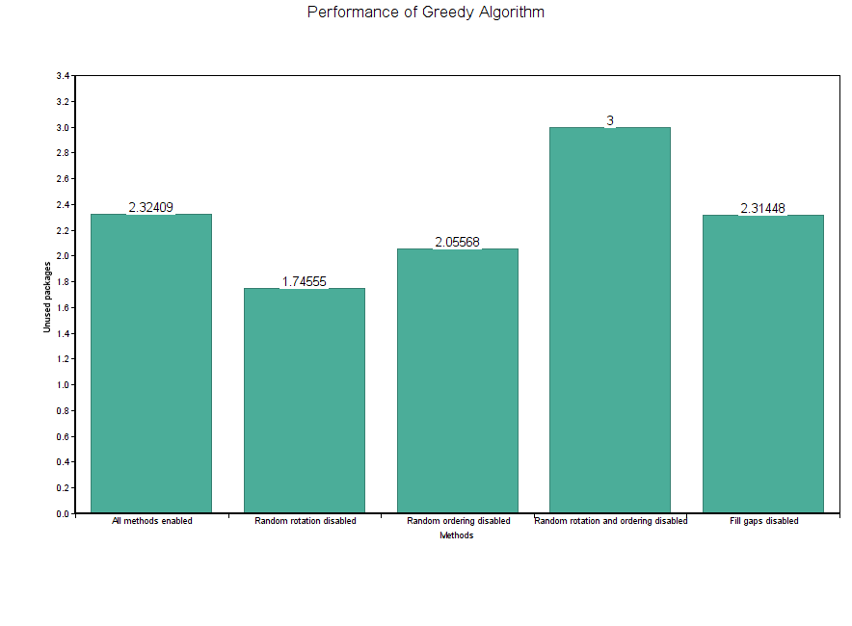
Packages that remain unused
10 packages
100000 runs

Slide 8
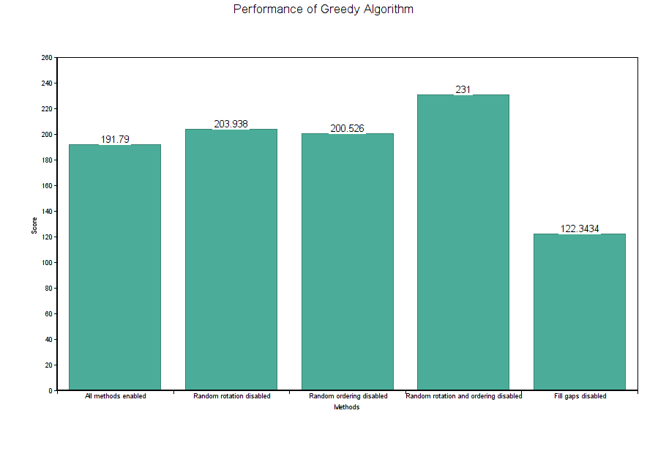
Finding the best total value
30 packages
1000 runs

Slide 9
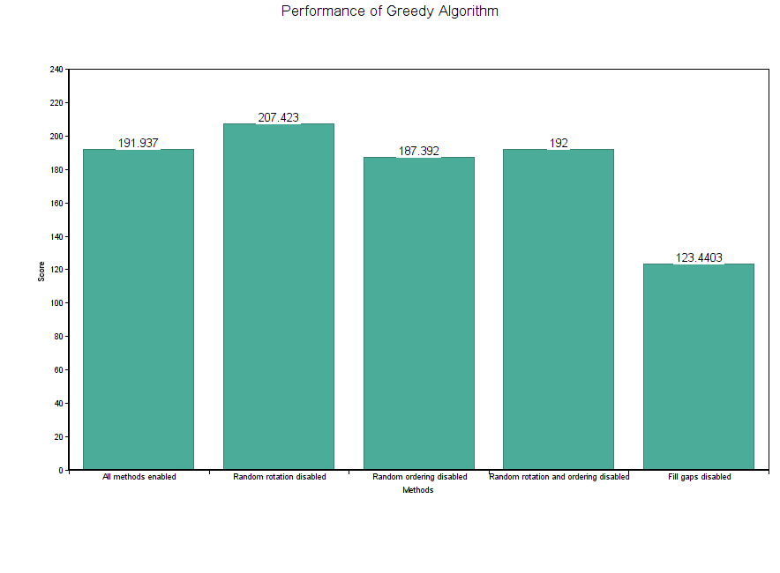
Finding the best total value
100 packages
1000 runs

Slide 10
HILL CLIMBING ALGORITHM

Slide 11
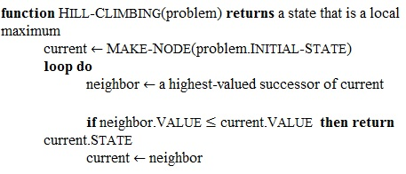
Implementation
Start with an arbitrary solution
Create neighbouring solutions(change random package and fill the remaining empty space)
Choose the best next solution based on an objective function (maximizing the value of a packing)
Repeat until no further improvements can be made

Slide 12
Experiments and results

Slide 13
GENETIC ALGORITHM

Slide 14
Implementation
Chromosomes (an array consisting of 0’s and 1’s) of each individual are generated randomly for the initial population.
These “genes” decide if a certain package in a certain state is included in the solution.
The binary string is converted into a packing to evaluate the fitness of an individual

Slide 15
Experiments and results

Slide 16
Comparison between algorithms
Greedy algorithm is the fastest but does not perform as well as other algorithms
Hill climbing algorithm might get stuck
Genetic algorithm is time consuming and has a lot of parameters that need to be taken into account (difficult to implement) but it is the most likely to find the optimal solution.
Which one has the best result using the same number of packages?

Slide 17
ASSIGNMENT RESULTS

Slide 18
Using rectangular packages
No solution to filling the entire cargospace with A,B and/or C packages has been found yet.
Best result found so far for maximizing a single packing: XXX

Slide 19
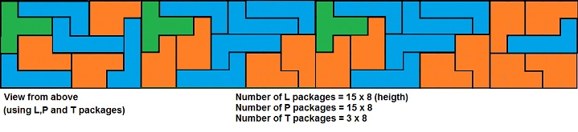
Using pentomino-shaped packages
It is possible to fill the entire cargospace with L,P and/or T packages.
Best result found so far for maximizing a single packing: 960

